Slide 1

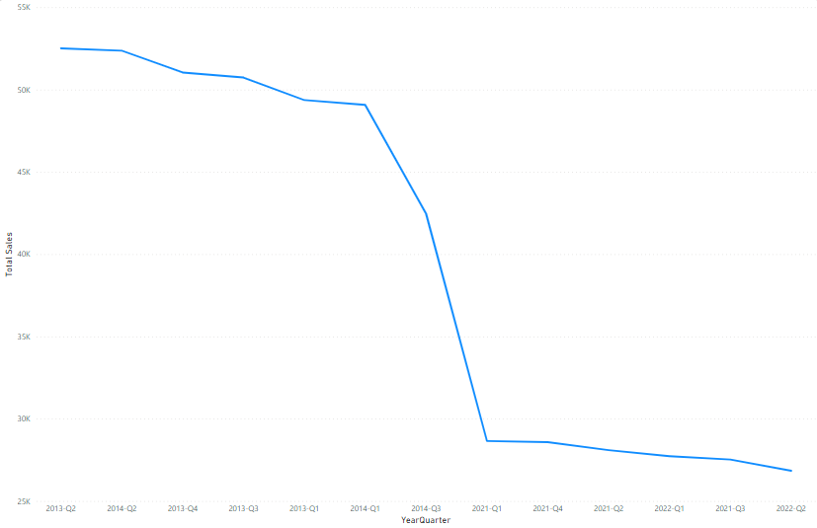
Automotive Sales Analysis
Overview
This project seeks to improve Automative sales amount.
The Problem
How can opportunities and sales orders be managed more efficiently to streamline operational processes?
What measures can be implemented to enhance financial processes, considering the relationships identified between purchase orders, approvals, and payments?
How can inventory and product management strategies be optimized based on insights derived from move numbers, unit list prices, and product preferences?
In what ways can customer engagement and satisfaction be improved, considering operational findings related to wish lists and receipt processing?
The Solution
Implement a centralized Customer Relationship Management (CRM) system.
Create dashboards for real-time visibility.
To overcome any bottleneck: Encourage faster payments by offering discounts for early payments.
Improve communication between departments involved in the financial process to reduce delays.
Implement dynamic pricing strategies regularly monitor customer feedback related to receipts.
Utilize the ERP system to track inventory levels, monitor product preferences, and analyze historical sales data.
Details
Sales Performance 2013-2022
Results Summary
Months 7, 8, and 9 in 2022: No Sales Recorded
Implication: Potential challenges in reaching sales targets.
Discussion Point: Explore reasons and identify strategies for improvement.
Months 10, 11, and 12 in 2014 and 2022: No Sales Recorded
Objective: Investigate historical trends.
Insight: Understanding the circumstances in 2014 can provide valuable insights for our current situation.
Highest Sales Recorded: 2013
Observation: The peak sales occurred in 2013.
Significance: Analyze factors contributing to success and consider replicating successful strategies.
Sales Trends in 2021: Consistent Monthly Performance
Observation: In 2021, sales exhibited a close range for each month.
Implication: A stable sales pattern in 2021 suggests a need to identify and leverage successful practices.

